Slide 1
Module 4 – Creating Custom Visualizations with View Builder

Slide 2
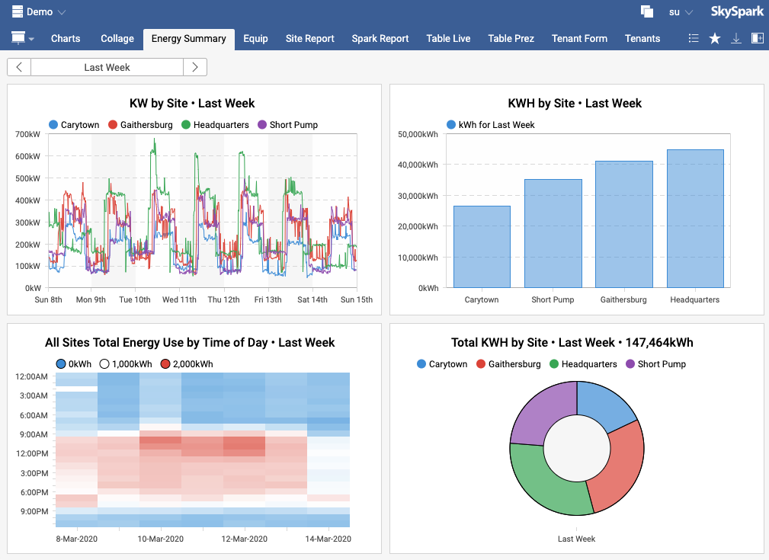
The UX – Making Data Analytics Meaningful
To make analytic results useful, visualizations should be easy for operators to understand and act on.
If the process of creating visualizations requires significant cost/effort the value of analytics is diminished.
SkyFoundry addresses this challenge with automatically generated Apps and custom views created with the View Builder tool.

Slide 3
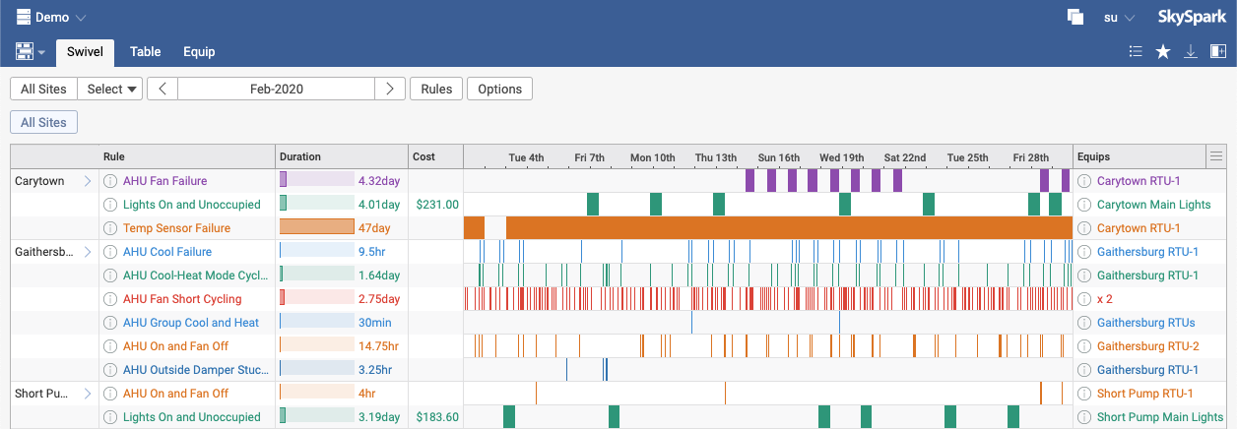
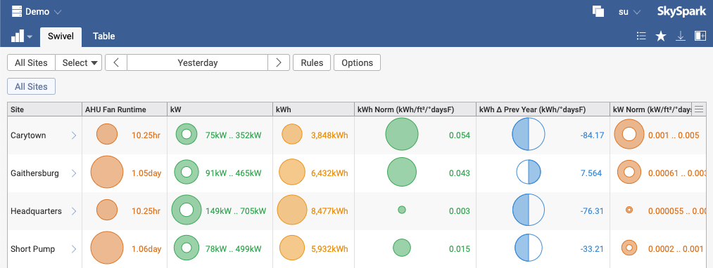
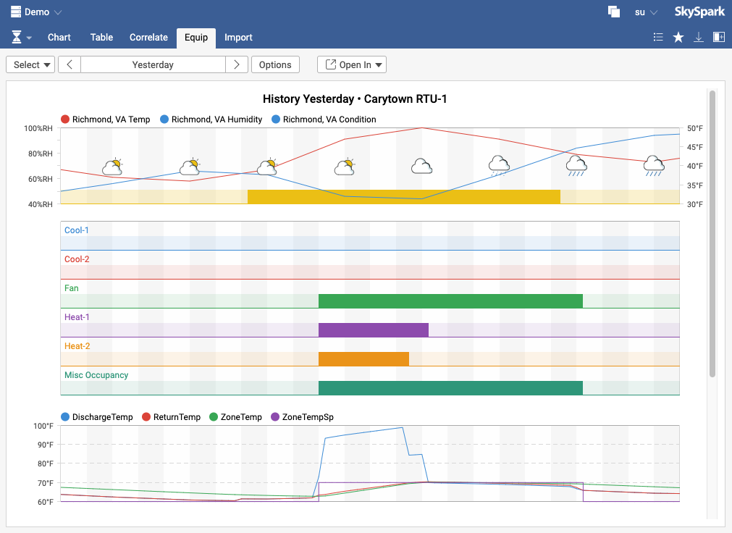
Efficiency - Automatic Generation of Visualizations
SkySpark’s built-in Apps automatically generate rich, intuitive visualizations without the conventional approach of requiring assembly of graphical displays.
Dramatically reduces implementation costs to show analytic findings, trends, correlations and relationships.
Automatic Apps include: Spark, Historian, KPI and Energy

Slide 4





The Visualization Continuum
Goal is to offer the best visualization solution for the customer with the minimum amount of effort.
Apps “just work”
Modify views with a few clicks
Combine standard Apps into custom views
Create custom views from Axon queries
External Apps access data via API
REST API + third-party development
View Builder Point & Click
View Builder + Axon
< No Effort UI Development Effort UI Programming >

Slide 5
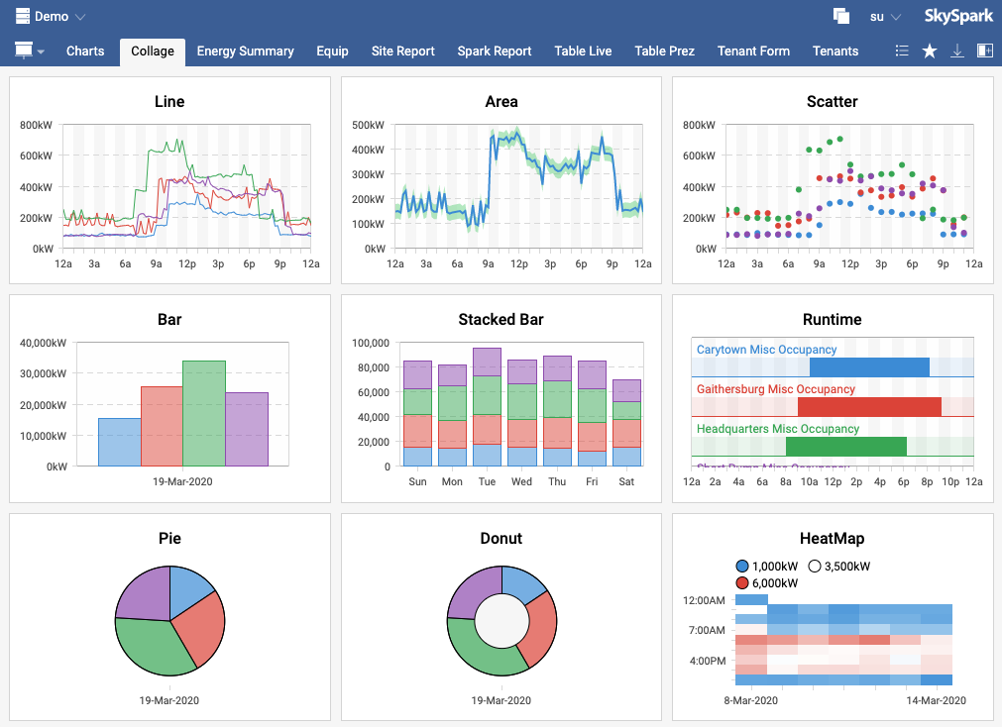
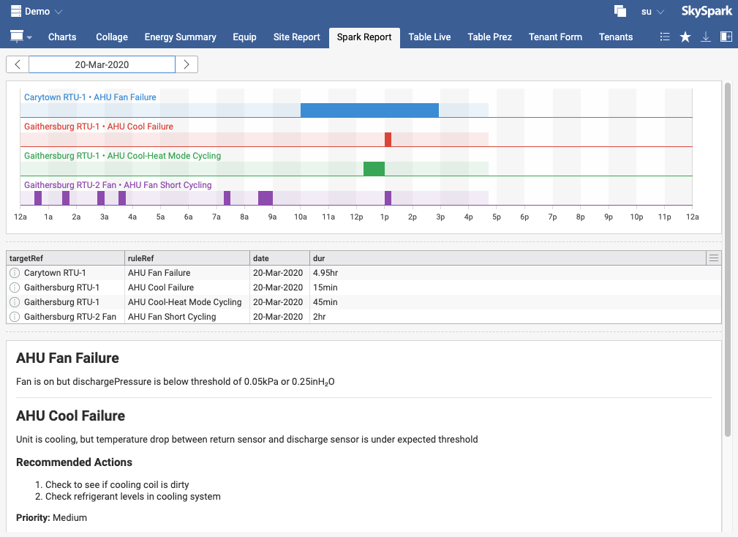
What is possible with SkySpark View Builder?
Assemble custom visualizations using a wide range of display widgets.
Combine the visualizations with formatted text and tables.
Use standard SkySpark Apps in custom multi-tiled views.
Create a dashboard or a report that can be viewed in the browser or exported as a PDF, SVG, etc.

Slide 6

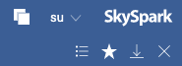
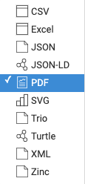

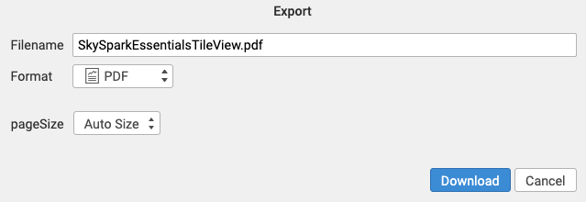
Turn Rich Information Views into Standard Reports
Any View can be saved as a report (called a Favorite, which will have the fav tag) using the save menu.
Any View in SkySpark can be manually exported to PDF (and many other formats) using the Export View button.
SkySpark can also be configured to automatically send Favorites as email attachments.
emailSend(recipients, subject, body, read(fav)->viewLink)
Emailing Views: https://skyfoundry.com/doc/docFresco/Export#email

Slide 7
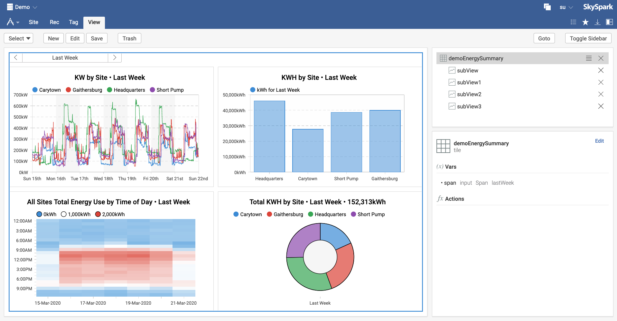
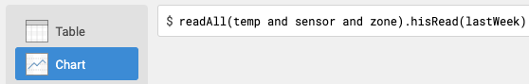
View Builder: A Point and Click Tool to Build Custom Views
SkySpark View Builder provides a Point and Click interface to create Views.
Data source is defined with standard SkySpark queries.

Slide 8
Creating a multi-tile View Using only Point & Click

Slide 9
Learning to Use View Builder

Slide 10










Visualization in SkySpark - Core Concepts
App: Light-weight "folders" to organize Views
View: Fundamental unit of data visualization
Variable: Values with a state that can change a View
Built-in View types:
Table: GridDef and ColDef
iFrame
Chart: Defined by grid col meta
Use Existing
Form: Template + submit action
Page: Paginated PDF reports (multi-view)
Text: Preformatted plain text
Page Break
Fandoc: Text to formatted HTML
Tile: Logical grid layout (multi-view)

Slide 11
A Look Forward to Key Topics
Making Apps
Making Views and assigning them to an App
Using Variables in the data source (allows for user interaction/selection)
Making subViews (Views can contain multiple subViews)
Binding subView variables (using one date selector for multiple views)

Slide 12
Apps

Slide 13
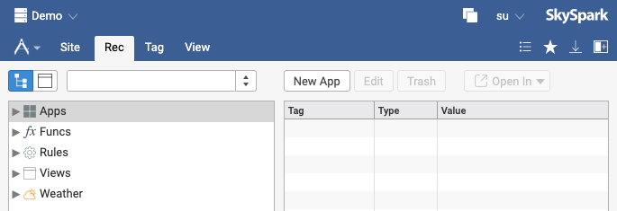
Apps – Creating an App to Organize Views part 1
Navigate to the Demo project.
Go to the Builder app Rec tab.
Click on Apps.
Click on New App.
Continue to next slide.
1
2
4
3

Slide 14
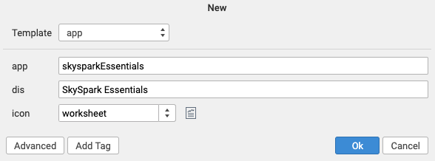
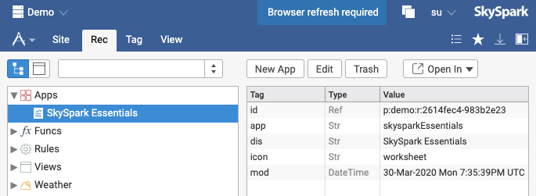
Apps – Creating an App to Organize Views part 2
In the New App dialog enter:
app: skysparkEssentials
dis: SkySpark Essentials
icon: worksheet
Click Ok.
Expand Apps to see all existing Apps in the project.
Click the notification at the top of the screen to refresh the browser.
1
2
4
3
In the following exercises, new Views are added to this App.

Slide 15
Views - Starting with Tables and Charts

Slide 16
Quick Intro to Axon
These examples use some Axon to define the data source of custom Views.
The read() command takes a given filter and finds a record in the database that matches the given filter.
The hisRead() command takes a given point or points and returns the history related to that point for a given DateSpan.
View Data Source Documentation: https://skyfoundry.com/doc/docFresco/Views#src

Slide 17
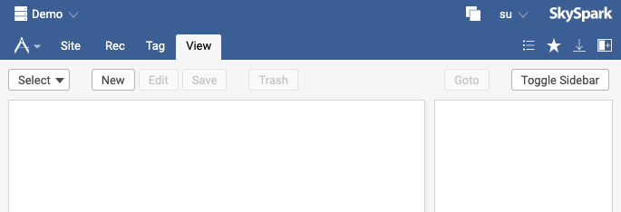
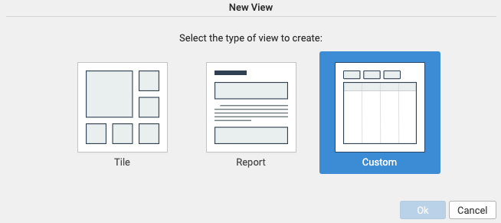
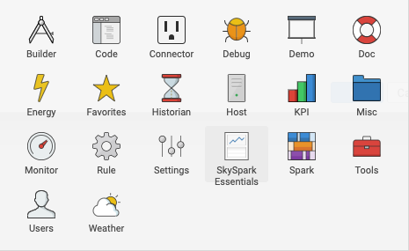
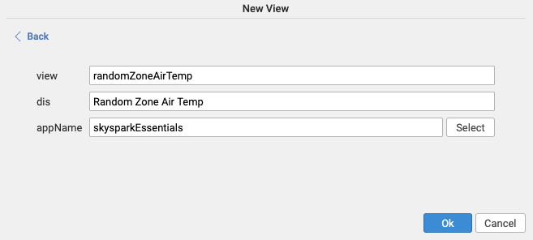
Making a Simple Custom View
1
Go to the View tab of the Builder app.
Click New.
Click Custom for the type of view.
In the New View Dialog enter:
view: randomZoneAirTemp
dis: Random Zone Air Temp
Click Select and choose SkySpark Essentials.
Click Ok.
Continue to the next slide.
2
3
4
5
Make sure the browser was refreshed or the new app will not appear in the Select dialog
6

Slide 18
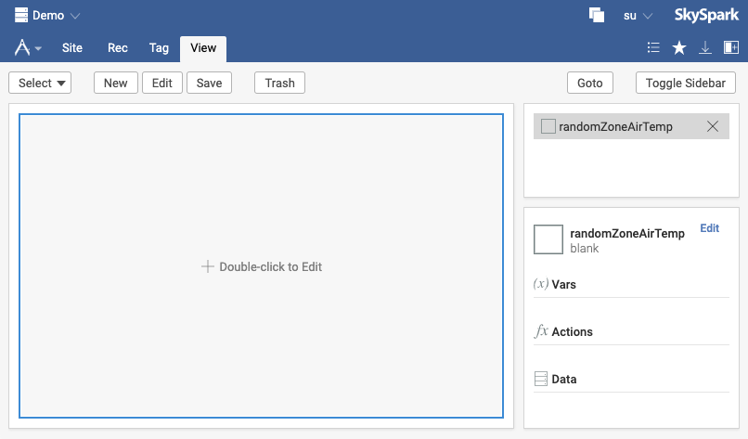
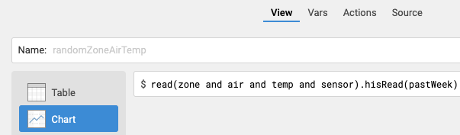
Edit the View and Define Data Source
Double-click on the View.
Click on Chart in the pop-up window.
Next to the $ type the query shown.
This defines the source of data for the view
This axon query returns the past seven days of data for a random zone air temperature sensor
Click Ok.
Continue to next slide.
1
When performing a read, don’t assume it will return the same record every time
3
2
read(zone and air and temp and sensor).hisRead(pastWeek)

Slide 19
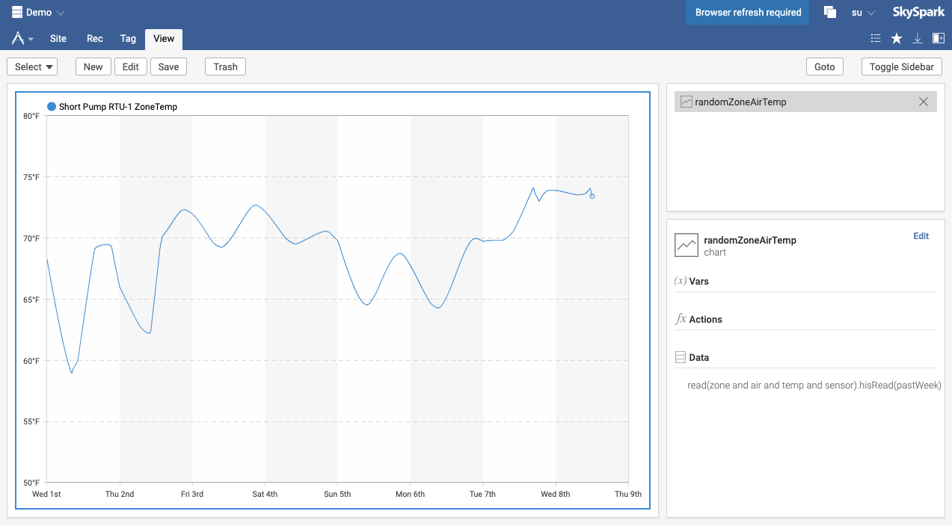
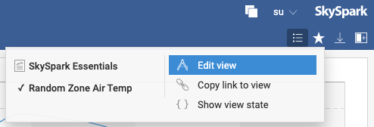
First Custom View Completed
Click Goto to display the finished view inside the SkySpark Essentials App.
Click the View Menu (with the 3 lines).
Click Edit View to jump back to the View Builder for the current View.
1
2
3
Double-click on the View to edit in the future

Slide 20
Using Variables in Views - Allowing Users to Dynamically Change the Displayed Data

Slide 21
Understanding Variables
Look at this Axon query:
Note that anything surrounded by the handlebars {{ }} symbols is a variable, which is points and span in this example.
When accessing a View that has variables of type input in the data source, the variables are replaced with values from a picker in the UI.
The code above automatically generates pickers in the UI for multiple point records and a span/date-range.
readByIds({{points}}).hisRead({{span}})
View Variables Documentation: https://skyfoundry.com/doc/docFresco/Views#vars

Slide 22
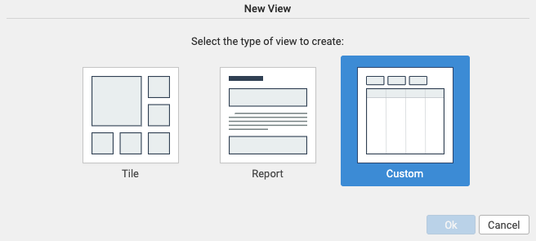

Making a View with a Custom Layout
Navigate to the Builder app View tab.
Click New.
Click the Custom type.
Enter the details for this View.
view: tableWithVariables
dis: Table With Variables
appName: skysparkEssentials
Click Ok.
Continue to next slide.
3
4

Slide 23
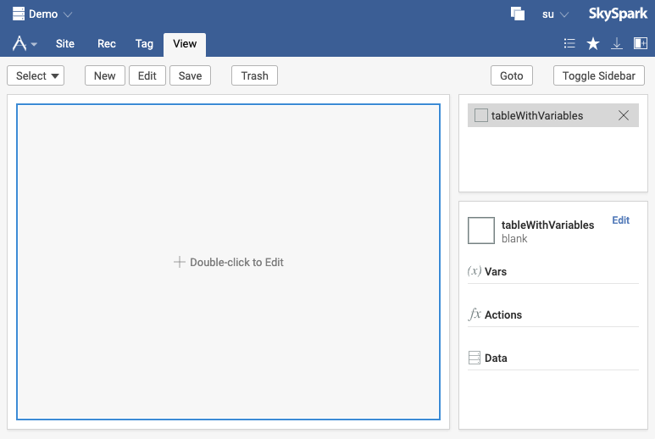
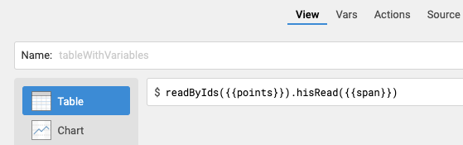
Define View Data Source with Variables
Double-click on the View.
Confirm Table is selected in the pop-up window.
Enter the Axon query shown.
Click the Vars tab.
Continue to next slide.
1
4
2
3
readByIds({{points}}).hisRead({{span}})

Slide 24
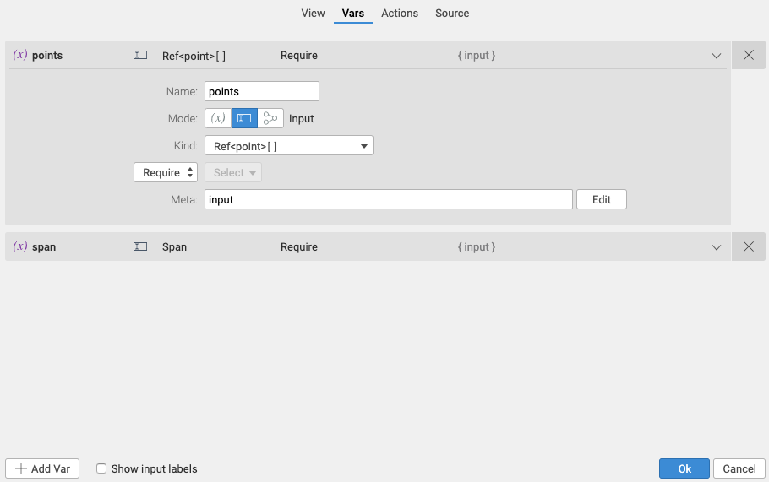
Configuring Variables for a View
On the Vars tab note that the points and span variables are automatically created.
Click on the points variable to see configuration details.
A variable with Mode: Input and Kind: Ref<point>[] adds a multi-point picker to the UI.
An input variable with Kind: Span automatically generates a span/date picker.
Click Ok.
Continue to next slide.
2
1
3
1
4

Slide 25
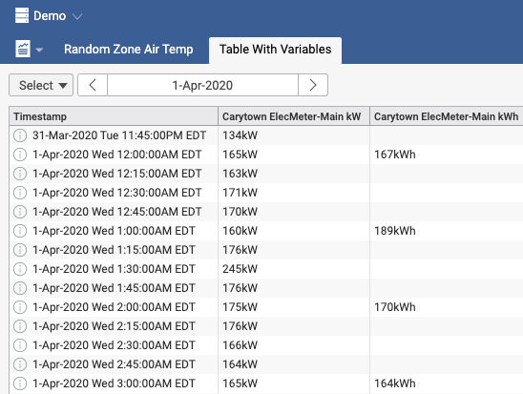
Access the Table With Variables View
Click Goto.
Select Carytown’s Main Meter kW and kWh points using the point picker.
Select yesterday using the date picker.
Continue to next slide.
2
3

Slide 26
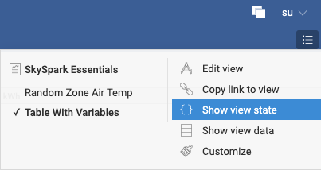
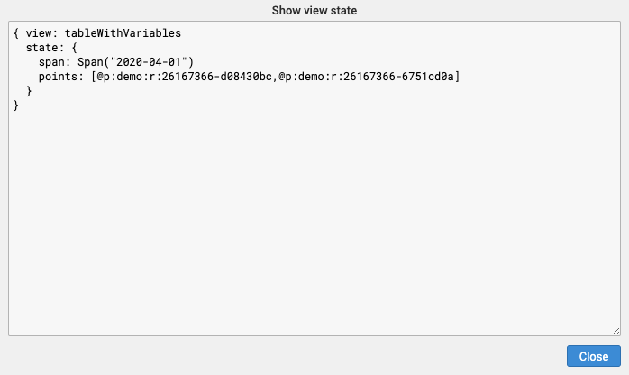
Show View State
Click the View Menu.
Click Show view state.
The values of the pickers are stored in the span and points variables.
Click Close.
1
2
3
4

Slide 27
Creating Tile Views and Defining the Variable Kind

Slide 28
Overview of Tile Views
Tile Views allow one or more subViews to be arranged within a View.
Tile Views by default appear in a 1 x 2 arrangement (1 column and 2 rows) and have 2 subViews.
The Tile arrangement is customizable.

Slide 29
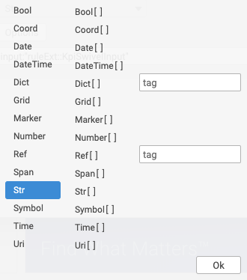
Variable Kinds
When creating a variable, if the following names are used, the default Kind shown is assigned:
point => Ref<point>
points => Ref<point>[ ]
equip => Ref<equip>
equips => Ref<equip>[ ]
site => Ref<site>
sites => Ref<site>[ ]
span => Span
dates => Span
All other variable names will be assigned the Kind: Str.
Pay attention to the Kind as a single value or List (brackets indicate a List) because not all Axon functions can take a list as an input, but some functions require a List (Ref is different from Ref [ ]).

Slide 30
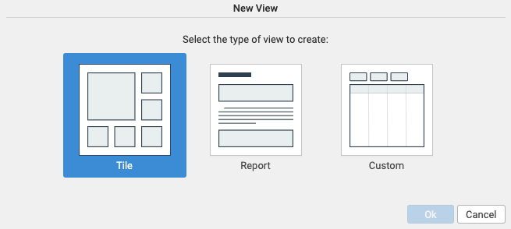
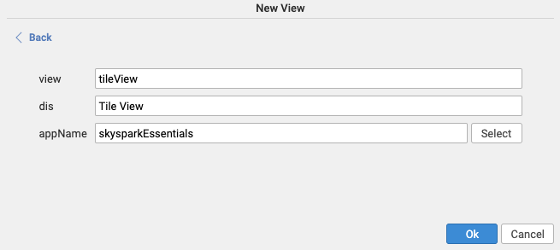
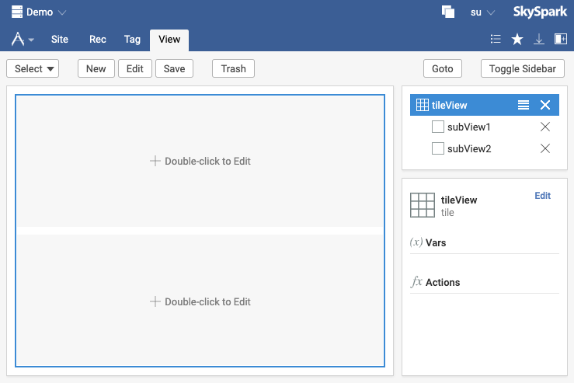
Create Tile View and Edit Root View
2
Open View Builder.
Click New and select Tile.
Enter details for this View:
view: tileView
dis: Tile View
appName: skysparkEssentials
Click Ok.
Click tileView in the View Builder Sidebar.
Click Edit in the View Builder Sidebar.
Continue to next slide.
3
4
5
6
Two Tile subViews are created by default

Slide 31
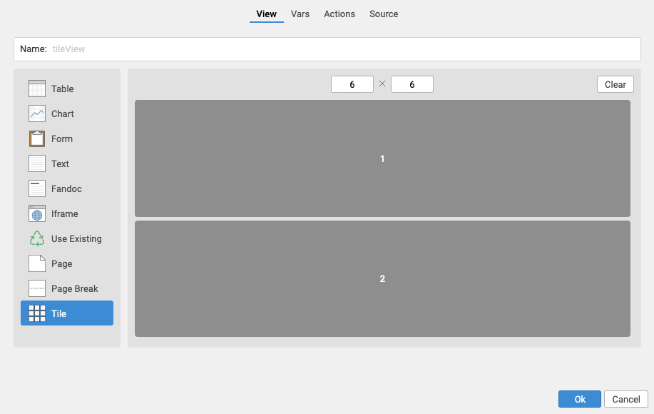
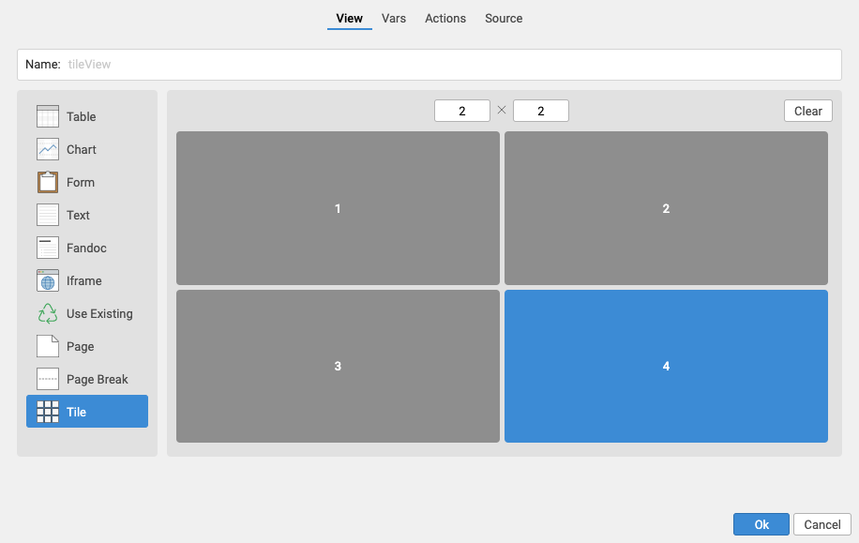
Changing the Tile Layout
Click Clear.
Change the layout to 2 x 2.
Click each of the 4 blank tiles one by one.
Click Ok.
1
2
3
4

Slide 32
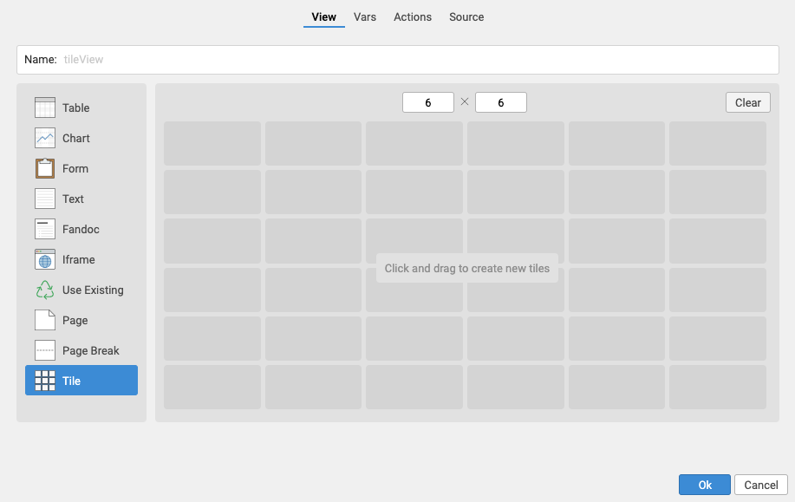
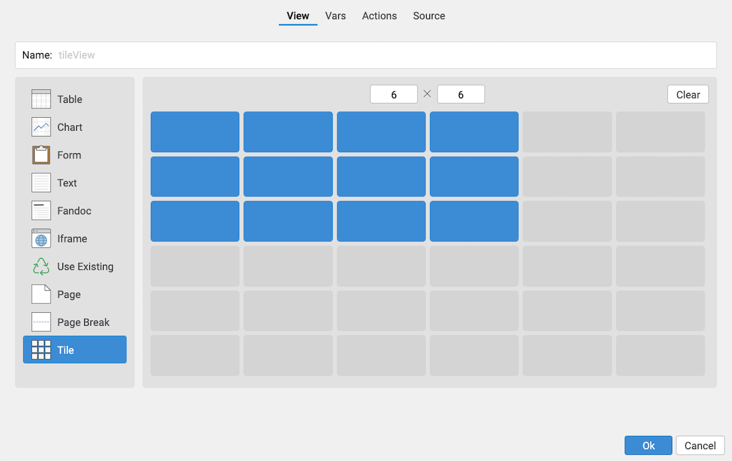
Click and Drag to Define a Custom Tile Layout
It is also possible to define a custom tile layout.
After clicking Clear, simply click and drag to create the desired tile arrangement.

Slide 33
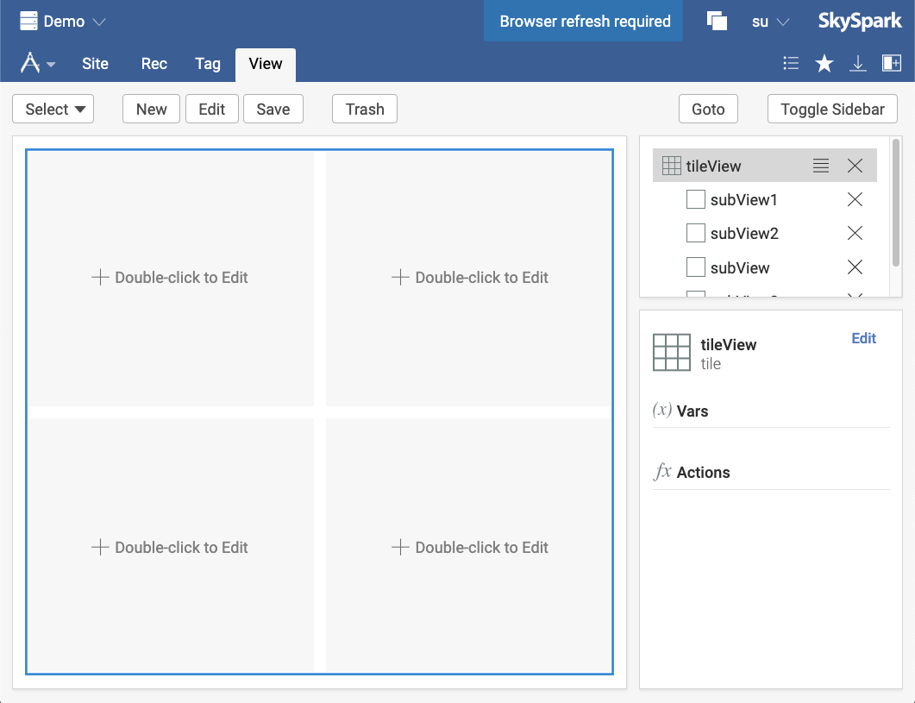
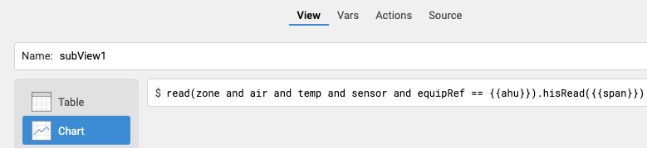
Top Left Tile subView Data Source
Double-click the Top Left subView tile.
Select Chart as the visualization.
Type the query shown:
This query finds the zone air temp sensor point record that has an equipRef equal to the value of a variable named ahu
Automatically creates a picker for the ahu variable and a span picker
Click Vars.
Continue to next slide.
1
3
2
read(zone and air and temp and sensor and equipRef == {{ahu}}).hisRead({{span}})

Slide 34

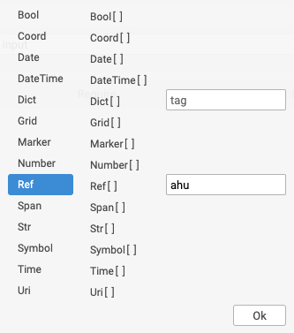
Defining the Kind of a Variable
Expand the ahu variable.
Click the Kind drop-down.
Select Ref as the Kind.
Type ahu into tag field.
Click Ok on the Kind dialog.
Click Ok.
Continue to next slide.
1
2
6
3
4
5

Slide 35
Remaining Tile subView Data Sources
In each step, after entering the query change the ahu variable Kind to Ref<ahu>.
Make the Bottom Left subView tile a Chart with this query :
Make the Top Right subView tile a Chart with this query:
Make the Bottom Right subView tile a Chart with this query:
Continue to next slide.
1
read("return" and air and temp and sensor and equipRef == {{ahu}}).hisRead({{span}})
The return tag must be in quotes because return is a reserved word in Axon and would cause an error otherwise.
readById({{ahu}}).toWeatherPoints.hisRead({{span}})
read(discharge and air and temp and sensor and equipRef == {{ahu}}).hisRead({{span}})

Slide 36
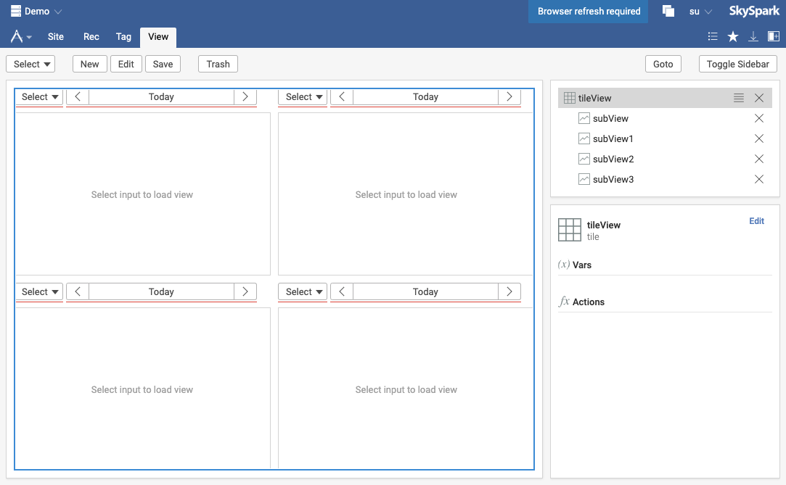
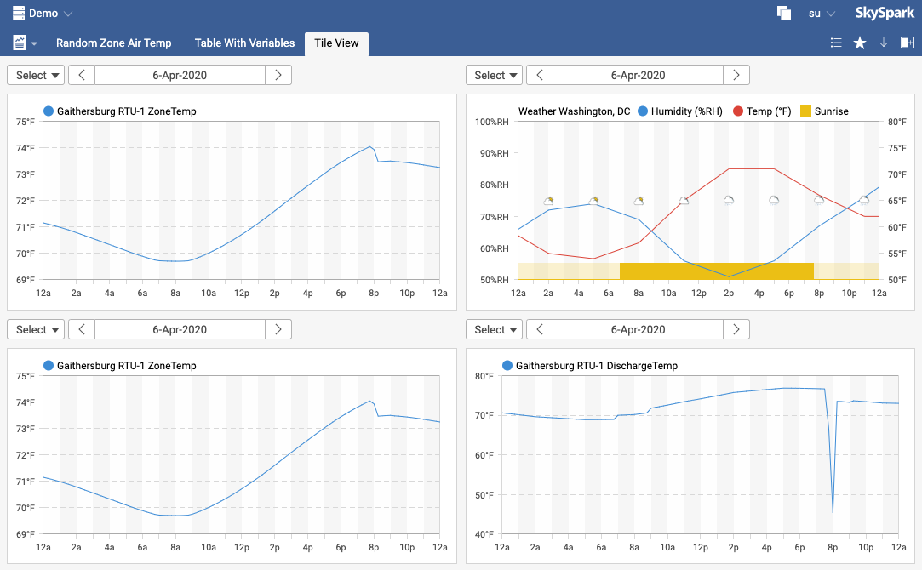
Use the pickers in each Tile subView
Click Goto.
Use the ahu variable picker and span variable picker to configure each Tile subView to Gaithersburg RTU-1 and yesterday.
Continue to the next exercise to learn how to improve this view.
1
2

Slide 37
Binding subView Variables to the Root View – Configuring subView Variables with a Single Selector

Slide 38
Variable Bindings
Usually a View with subViews will use the same value for common variables.
Instead of setting each variable to the same value individually in each subView, a variable can bind to another variable so that one picker sets the value for all bound variables.
Variable Bindings Documentation: https://www.skyfoundry.com/doc/docFresco/Views#bindings

Slide 39
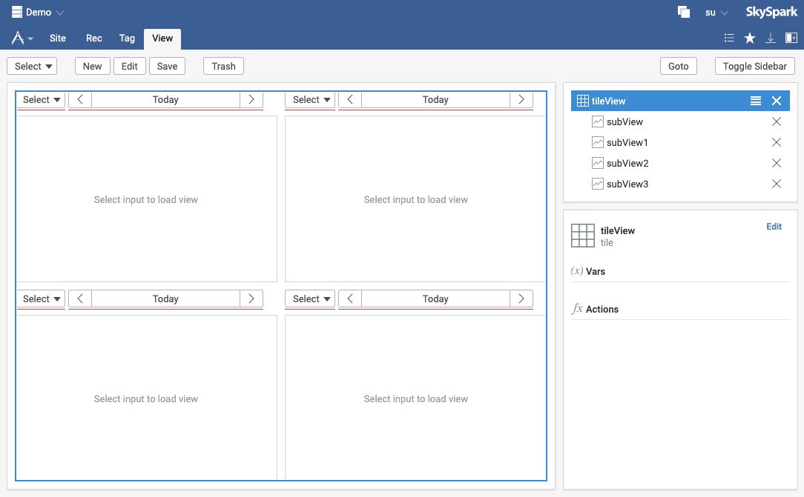
Using the View Builder Sidebar
Navigate back to the View Builder to edit the existing tileView (remember the Edit view option in the View Menu).
Click tileView in the View Builder Sidebar.
Click Edit in the View Builder Sidebar.
Continue to next slide.
2
3
Double-clicking on a View or subView in the View Builder Sidebar will also open the edit dialog

Slide 40
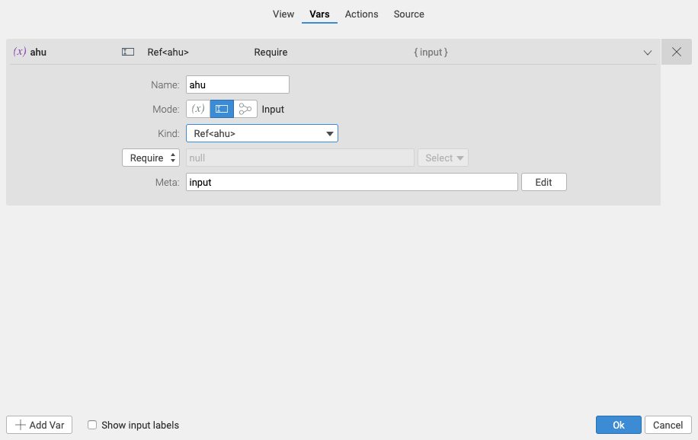
Manually Create ahu View Variable
1
Select the Vars tab.
Click Add Var.
Enter ahu as the Name, set input as the Mode and define the Kind as Ref<ahu>.
Continue to next slide.
3
2

Slide 41
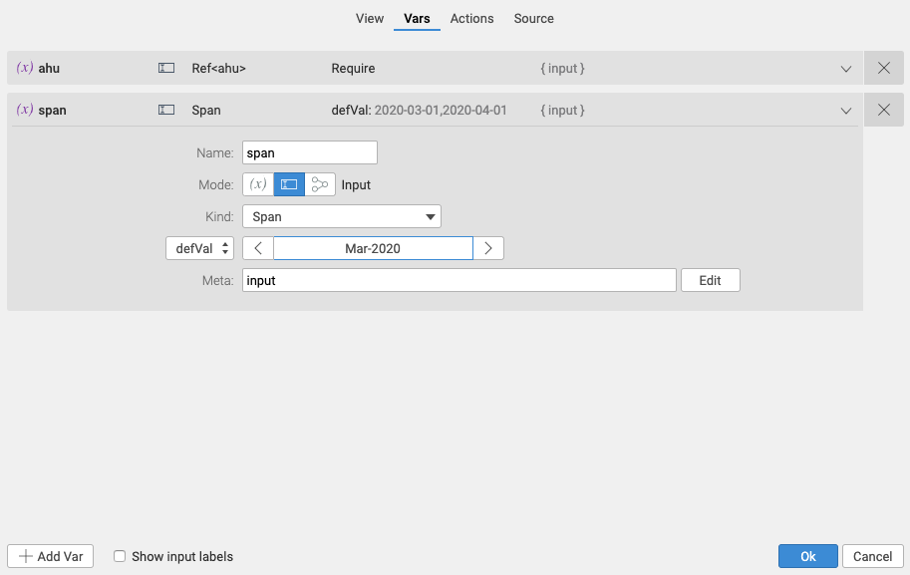
Manually Create span Variable with Default Value
Click Add Var.
Enter span as the Name, set input as the Mode and define the Kind as Span.
Click Require dropdown menu and select defVal.
Use the span picker to set the defVal to lastMonth.
Click Ok.
Continue to next slide.
2
3
4
1
5

Slide 42
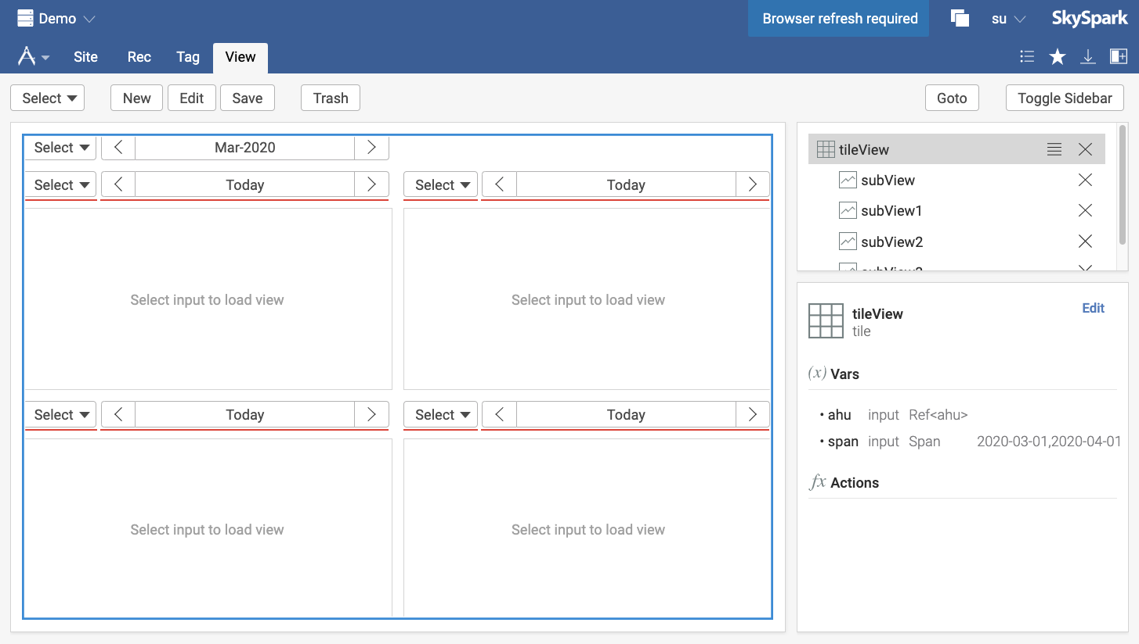
Confirm Root View Pickers
Confirm the new pickers.
Continue to next slide.
1

Slide 43
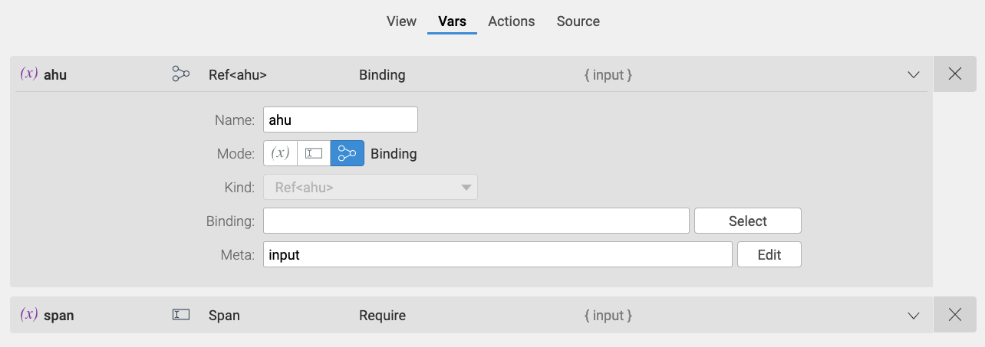
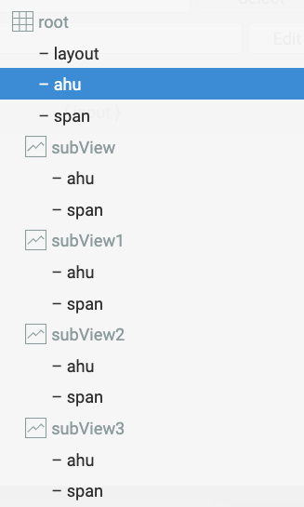
Bind subView ahu Var to Root ahu Var
Double-click the Top Left subView tile and then click the Vars tab.
Click the ahu variable.
Change the Mode to Binding.
Click Select next to the Binding input.
Click the root ahu variable.
Continue to next slide.
2
3
4
5

Slide 44
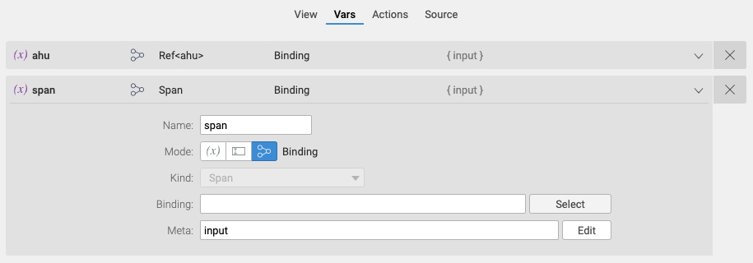
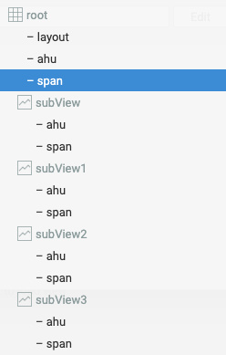
Bind subView span Var to Root span Var
Click the span variable.
Change the Mode to Binding.
Click Select next to the Binding input.
Click the root span variable.
Click Ok.
Continue to next slide.
1
2
3
4

Slide 45


Repeat Binding for Remaining Tile subViews
Repeat each step on the remaining 3 Tile subViews.
Change the subView ahu variable Mode to Binding and bind to the Root ahu variable.
Change the subView span variable Mode to Binding and bind to the Root span variable.
Continue to next slide.

Slide 46


Complete Tile View
Click Goto.
Use the ahu variable picker to select Gaithersburg RTU-1 and verify each subView is updated.

Slide 47

Reordering subViews
Note that the stacked horizontal lines on the rootView near the top right allow subViews to be reordered.
This is a quick way to drag and drop a tile to a different location.
Notes:
TODO: Determine where this goes

Slide 48
Customizing Navigation

Slide 49
Overview of Navigation
By default, equip records are grouped under their site and point records are grouped under their equip.
The navigation can be customized using any tag.
Documentation for Nav: http://www.skyfoundry.com/doc/docFresco/Nav

Slide 50


Customizing the Navigation
Go to the Settings app UI tab.
Click Config Target and select site as the Target Tag.
Enter geoState for the siteNav tag.
Click Ok.
Click Submit.
Continue to next slide.
5
2
3
4

Slide 51



Testing the Navigation
Click Test Nav to show how the picker will work in all modern Apps.
Type ahu in the Target field.
Click Select to preview the navigation for records with the ahu tag.
The ahu picker now shows the records with the ahu tag grouped by their geoState and siteRef tag.
Click Ok twice to exit the Test Nav window.
1
4
2
3
5

Slide 52
Completed View
Navigate back to the Tile View and check out the new navigation.
Select the equip Gaithersburg RTU-1.

Slide 53
Report Views and Fandoc

Slide 54

Overview of Report Views and Fandoc
Report Views are useful for making reports that include text to explain each visualization.
Report Views include an add subView button in the View Builder Sidebar.
Report Views are designed to be easy to export to PDF.
Documentation for Fandoc: http://www.skyfoundry.com/doc/fandoc/index#overview

Slide 55


Fandoc – Simple Text Formatting
In the Builder app View tab, create a new Report View:
view: myReport
dis: My Report
app: skysparkEssentials
Double-click the heading subView to see Fandoc as the type.
Select Text and add the content to the text section.
Click Ok.
**This is my title. There are many like it but this one is mine.**
*I want to emphasize these points*
- Visualizations are easy in SkySpark.
- Visualizations are fun in SkySpark.
Note the syntax for bullets is [space][dash][space][text]
3
1
2

Slide 56

Adding Grid Meta to Change Behavior/Display
Double-click subView1 and select Chart.
Enter this query:
Click Ok.
Click Goto.
readAll(power).hisRead(lastWeek).addMeta({title: "Demand"})
Documentation for Grid Meta: https://www.skyfoundry.com/doc/docFresco/Charts#gridModel

Slide 57
Use Existing App Views and iFrames in Custom Views

Slide 58


Using Existing Views part 1
Create a new Tile view called useExistingMashup and assign to an App.
Make the Tile View a 2x2.
Click Ok.

Slide 59

Use Existing Views part 2
Double-click the Top Left subView tile.
Select Use Existing.
Select the KPI app and select the Swivel View in the right column.
Click Ok.
Repeat steps 1-4 for the Bottom Left subView and select the Energy app and the Usage View.
Repeat steps 1-4 for the Top Right subView and select the Spark app and the Swivel View.

Slide 60

Add iFrames to a View
Double-click the Bottom Right subView tile.
Select iFrame and enter `https://skyfoundry.com`.
Click Ok.
Note the use of back-tick ( ` ) not single quote ( ‘ )

Slide 61

Enjoy the View!
Click Goto.
Individually select sites for the three existing views or click on All Sites.

Slide 62
Setting the Order of Views in an App

Slide 63

Adding the Order Tag
By default, Views will be ordered inside an App using the dis tag.
Adding the order tag with a number value to the view record allows the order of Views to be defined explicitly.

Slide 64




Define the first View in an App
Open the Use Existing Mashup View in View Builder.
Click the Edit button near the top of the screen.
Click Add Tag.
Enter order:1
Click Add.
Click Ok.
Click Goto.
2
3
6
4
5

Slide 65

View Records can also be edited in the Builder App
The Builder app Rec View is useful for quickly checking the tags on view records.
The Open In menu has some handy shortcuts.

Slide 66
Setting View Default and Saving Favorites

Slide 67



Defining View State
There are a couple ways to control the state of variables for users.
When on a View, the Set as View Default option in the Favorites menu will control what is displayed by default for all users.
The Save as Favorite option will take the current state of the View and add it to the Favorites app.
Favorites are also available directly via the Favorite menu.

Slide 68
Example Axon Queries

Slide 69
Example Axon Queries (a quick cheat sheet)
readById({{point}}).hisRead({{span}})
readByIds({{points}}).hisRead({{span}})
readByIds({{equips}})
readByIds({{sites}})
readById({{equip}}).ruleSparks({{span}}).ruleSparkHis
readById({{point}}).toEquips.ruleSparks({{span}}).ruleSparkHis
readAll(power and equipRef == {{meter}}).hisRead({{span}})
readAll(temp and siteRef == {{site}}).hisRead({{span}})

Slide 70
Security Considerations

Slide 71
Consider End User Roles and Filters for Applications
The userRole tag controls the ability to write to a project database.
su: super user accounts manage projects and host-level settings
admin: administrator accounts have full read/write access to manage a given project database
op: operator accounts have readonly access to a given project
When creating apps and views, remember that it is easy to control what end users can access using tags on their user record.
The projectAccessFilter tag limits what project a user can access based on the tags applied to the projMeta record.
The appAccess tag limits what apps a user can access.
SkySpark Security Model: http://www.skyfoundry.com/doc/docSkySpark/Security

Slide 72
End of Module 4

Slide 73
Optional Module 4 Homework

Slide 74
Easily Moving Apps/Views/Templates Between Projects

Slide 75

Exporting Visualization Recs from a Project
Select the Demo project from the project selector.
Go to the Tools app and execute this Axon command to create a trio file of all app, view, and template records:
readAll(app or view or template).removeCols(["id","mod"]).ioWriteTrio(`io/theViews.trio`)
1
2
SkySpark projects can only write to their io directory

Slide 76

Importing Visualization Recs to a Project
Using file management tools outside of SkySpark, move the trio file from the demo io folder to the training io folder:
Move: var/proj/demo/io/theViews.trio
To: var/proj/training/io/theViews.trio
Select the Training project from the project selector.
Go to the Tools app and execute this Axon command to import the trio file into the training project:
2
3
SkySpark projects can only read from their io directory
ioReadTrio(`io/theViews.trio`).map v => commit(diff(null, v, {add}))

